Slide 1
English Odyssey
Tomáš Hojgr

Slide 2
Reform of written English

Slide 3
"Goodbuy"

Slide 4
Goodbye

Slide 5
Brake x break

Slide 6
Sell x cell

Slide 7
Declaration of War

Slide 8
Goals
Change the writing system
Make it:
Working
Useful
Simple
Intuitive
Universal

Slide 9
The 1st Stand-Off

Slide 10
Letters
Consonants
Vowels
B, C, D, F, G, H, J, K, L, M, N, P, Q, R, S, T, V, W, X, Z
Y
A, E, I, O, U
Y

Slide 11
Consonants, act I
Y - /j/
You, yesterday, year
J - /dʒ/
John, jester, jinx
Jentle, jems, jerund
G - /ɡ/
Grammar, great, grand

Slide 12
Consonants, act II
S - /s/
Spear, star, sorry
K - /k/
or
C - /k/
Key/cey, Cambridge/Kambridge, cool/kool

Slide 13
Consonants, Final act
Sh - /ʃ/
English, shore, shatter
Ch - /tʃ/
Chest, teacher, search

Slide 14
Status: Win

Slide 15
The 2nd Stand-Off

Slide 16
Vowels as sounds
/i/ as in police, feet, eat, and silly
/ɪ/ as in it, sit, kick, myth and bitter
/ɛ/ as in end, bet, less, and letter
/æ/ as in at, apple, fat, and matter
/u/ as in cool, tune, soup, and kung fu,
/ʊ/ as in cook, should, pudding, and foot, root
/ʌ/ as in bus, blood, come, and up
/ə/ as in kingdom, photography, philosophy, ketchup, and hundred
/ɚ/ as in butter, collar, flavor, firm, and burst
/ɔ/ as in all, fought, hot, and bot
/ɑ/ as in father, walk, arm, heart, wasp, lager, envelope

Slide 17
Process of changing

Slide 18
Analogy of Fundamentals

Slide 19
Pillar system
Queen
Excuse me
Tea
Freedom
Guns
Oil

Slide 20
E
English - /ˈɪŋ.ɡlɪʃ/
Englesh x Inglish
e – EN: /ɪ/
CZ: [i/y]

Slide 21
I
Christ - /kraɪst/
Chreist x Chriest x Chreyest x Chrayst x Chryst
I - /aɪ/
Ei x Ie x (Eye) x Ay x Y
i – EN: /aɪ/
CZ: [áj]

Slide 22
The Last of Analogy
Escape - /ɪˈskeɪp/
Escape x Iscape
/ɪ/ - e
/ai/ - i

Slide 23
Status: Lost

Slide 24
Defining ones worth

Slide 25
Frequency practise
Corpus - a collection of written or spoken material stored on a computer and used to find out how language is used
Corpus - The frequency distribution

Slide 26
Top 10
the
be
of
and
to
a
in
that
for
have

Slide 27
Proportional system

Slide 28
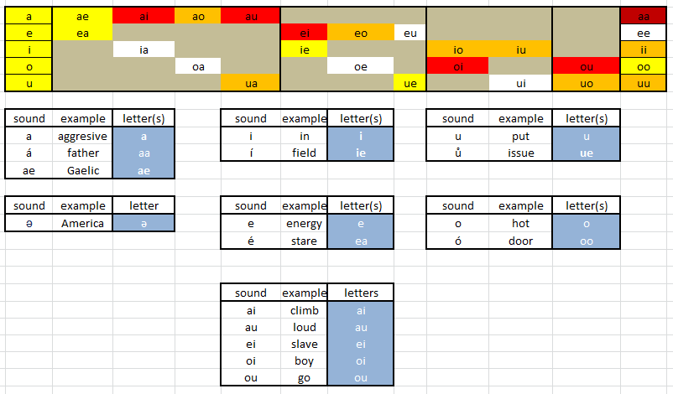
Matrix

Slide 29
Key to Communication

Slide 30
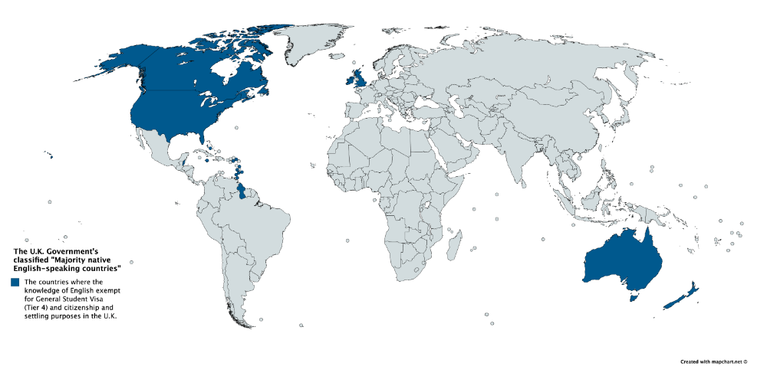
English speaking countries

Slide 31
Parallel paradox

Slide 32
Differentiation of English

Slide 33
Internet

Slide 34
Goals
Change the writing system
Make it:
Working
Useful
Simple
Intuitive
Universal

Slide 35
Status: Devastating Loss

Slide 36
Ask me now!

