Slide 1
4 %

Slide 2
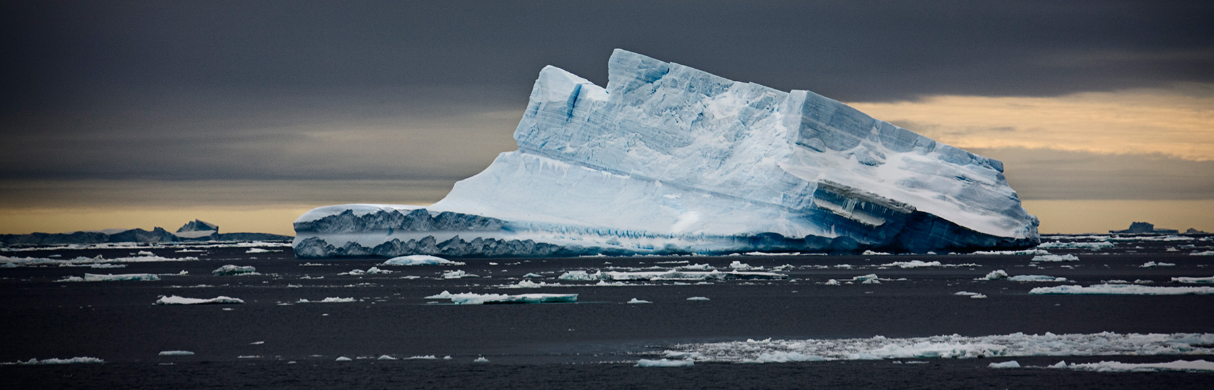
DEEP WEB/DARK WEB
Lucie Kozelková, 1.C
A threat to humanity?

Slide 3
You use it every day.

Slide 4
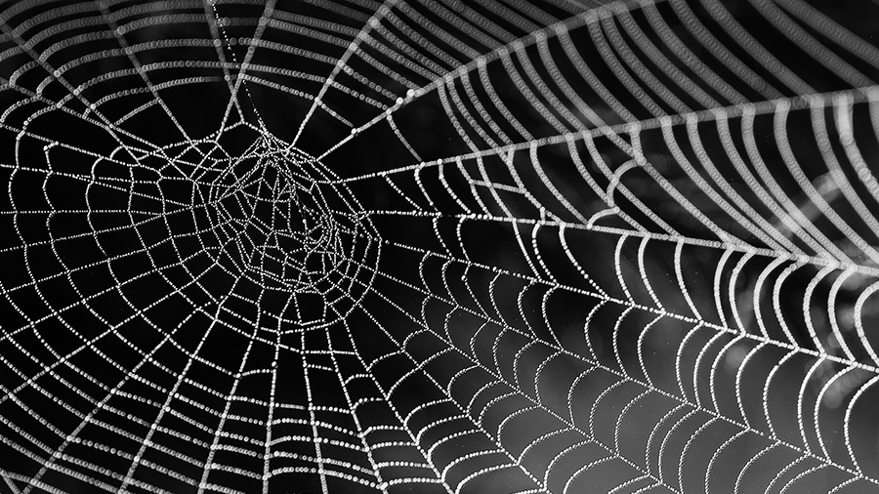
DEEP WEB
= a part of the Internet not accessible with normal search engines (ex. Google)
protected by a password
DARK WEB
= a part of the Internet accessible only with special software
a part of the deep web

Slide 5
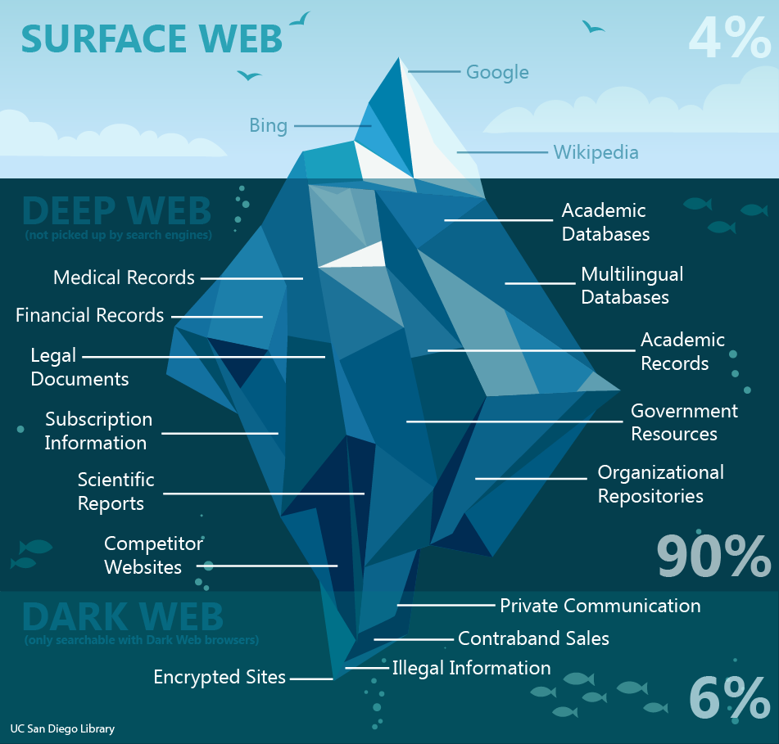

Slide 6
How does it work?
Runs on darknets
TOR – onion routing
Anonymity
Founded and still funded by the government

Slide 7
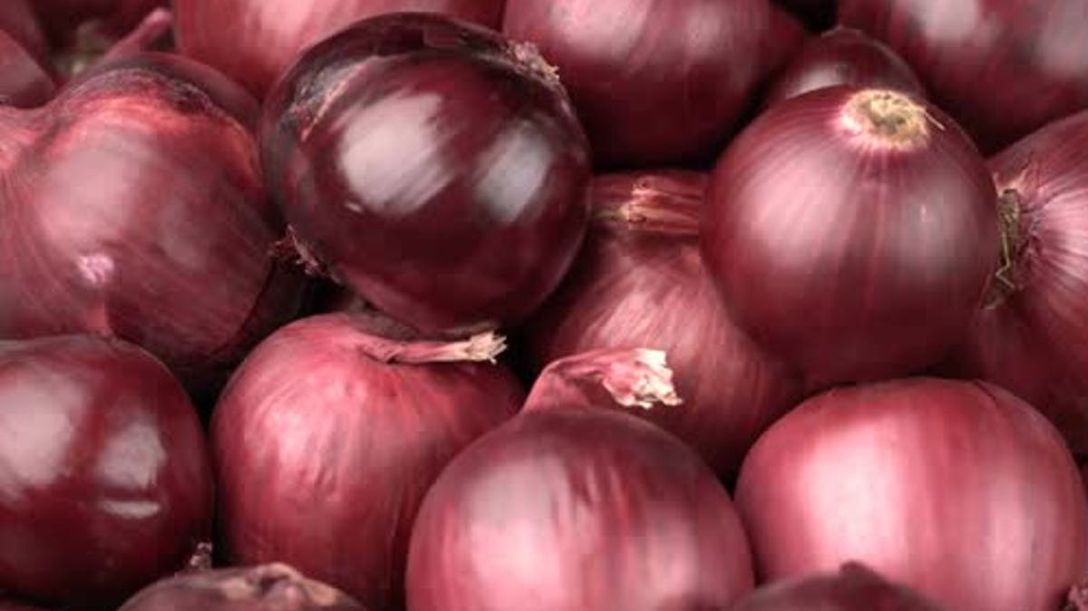
Hiddenwiki7wiyzr.onion

Slide 8
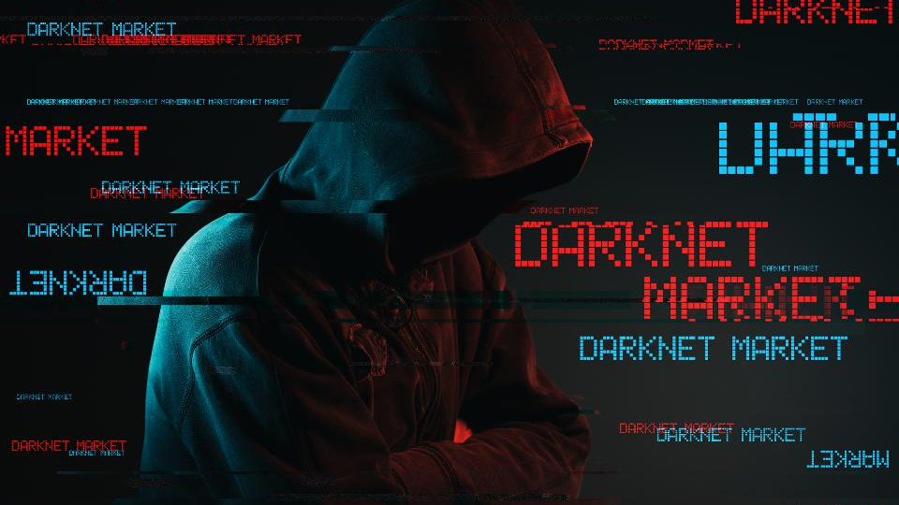
What can you find?
Mostly darknet markets
Guns, drugs, other services (hitmen)
File sharing (personal data)
Whistleblowers and news leaks
Information dropping services

Slide 9
Drugs, guns, counterfeit money
Creator got 2 life sentences
2011 – 2013
9.5 million Bitcoin

Slide 10
However…
A safe haven for dissidents
Free of censorship
Vital for journalism

Slide 11
- the discussion part -
A threat to humanity?

Slide 12
Sources
Iceberg with Yellow Sky by Camille Seaman. In: Susan Spiritus Gallery [online]. Irvine: Susan Spiritus Gallery, 2010 [cit. 2020-02-13]. Dostupné z: https://susanspiritusgallery.com/wp-content/uploads/2014/06/MG_4884_pt2.jpg
https://en.wikipedia.org/wiki/Dark_web#Content
https://en.wikipedia.org/wiki/Darknet
https://en.wikipedia.org/wiki/.onion
https://www.youtube.com/watch?v=mA8pNpPvrr0
https://en.wikipedia.org/wiki/Silk_Road_(marketplace)
https://en.wikipedia.org/wiki/Deep_web
https://cdn.inquisitr.com/wp-content/uploads/2020/01/Spider-web-625x302.jpg
https://previews.123rf.com/images/cookelma/cookelma1303/cookelma130300003/18232008-background-heads-red-onions.jpg
https://img3.exportersindia.com/product_images/bc-full/2019/11/6502979/onion-1573118652-5144933.jpeg
https://blog.radware.com/wp-content/uploads/2019/02/darknet-960x656.jpeg
https://images.unsplash.com/photo-1547761661-0a723e5b3b4d?ixlib=rb-1.2.1&ixid=eyJhcHBfaWQiOjEyMDd9&w=1000&q=80
https://d1yjjnpx0p53s8.cloudfront.net/styles/logo-thumbnail/s3/032018/untitled-1_568.png?uvrqhyWHJ2UbDjcsYeZSZ7lsnMIKGzR_&itok=4IG-OEAQ

Slide 13
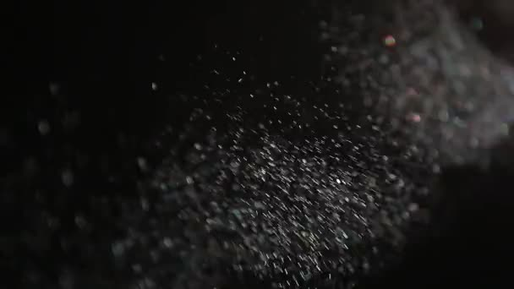
THANK YOU FOR YOUR ATTENTION
Stay safe, my friends! ;)

