Slide 1
How to control an airplane
by Jindřich kašparec

Slide 2
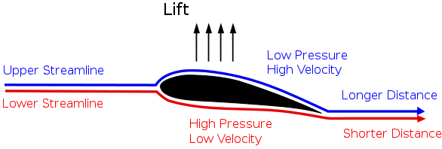
How do airplanes fly?
Aircraft use wings to generate lift
Lift is an upward force
Angle of attack is angle between the body's reference line and the oncoming flow

Slide 3
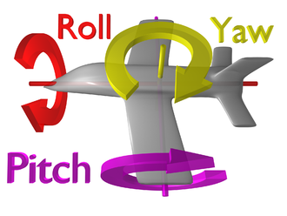
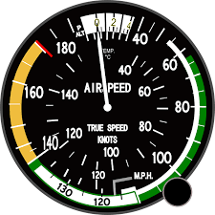
What do we control?
Speed
3 axes of motion
Pitch
Roll
Yaw

Slide 4
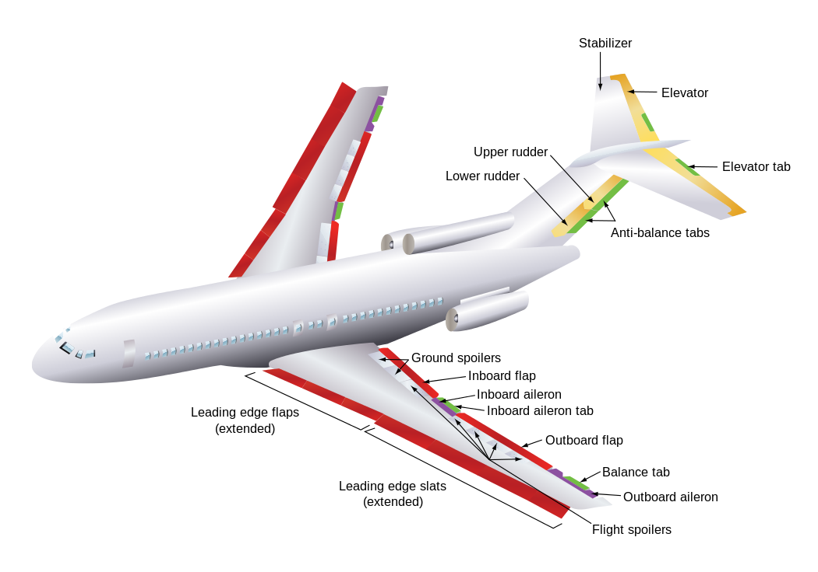
Primary flight control surfaces
Ailerons (roll)
Elevator (pitch)
Rudder (yaw)

Slide 5
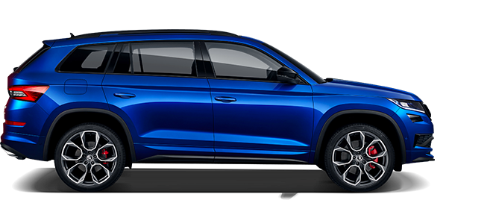
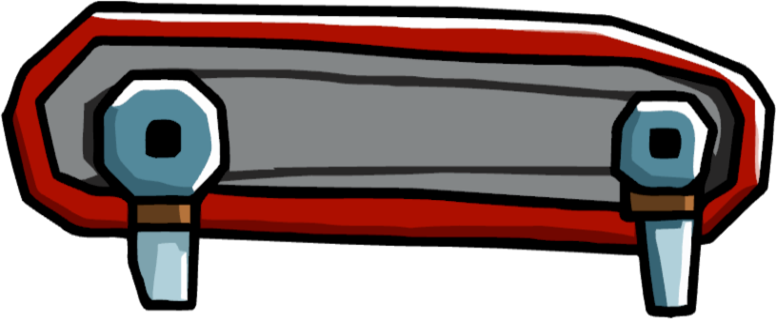
Speed
It is controlled by thrust of an engine
Can be measured by pitot tubes
Indicated airspeed, true airspeed, ground speed

Slide 6
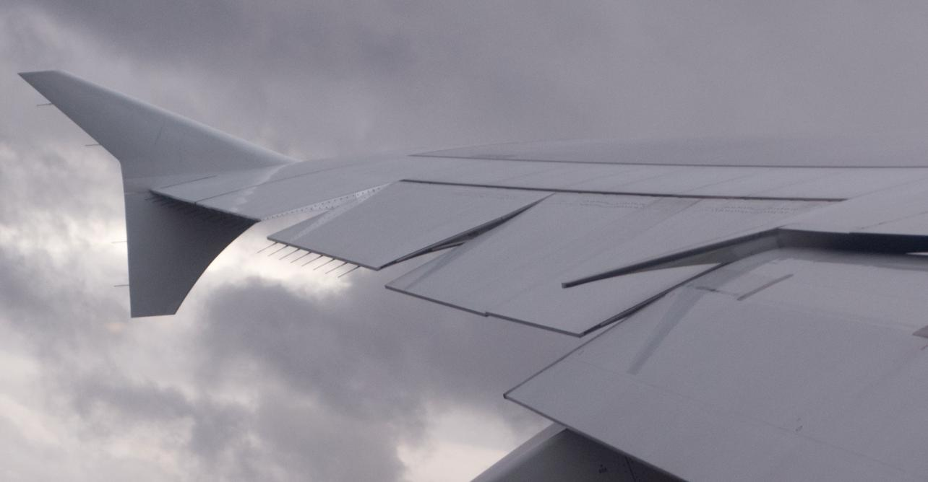
Ailerons
Controll roll (often called „bank“)
Located on the wings
Can deflect up or down

Slide 7
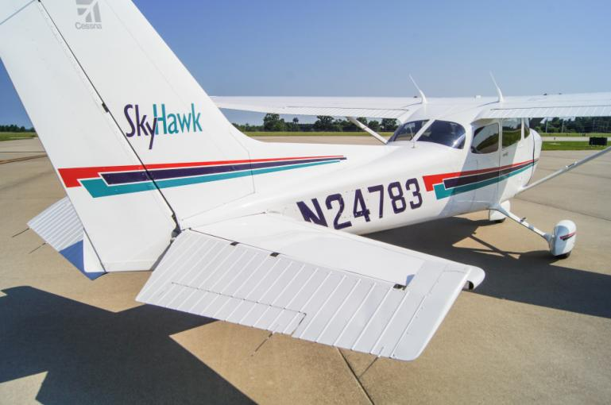
Elevator
Controlls pitch
Located on horizontal stabilizer
Counteracts the movement of center of gravity

Slide 8
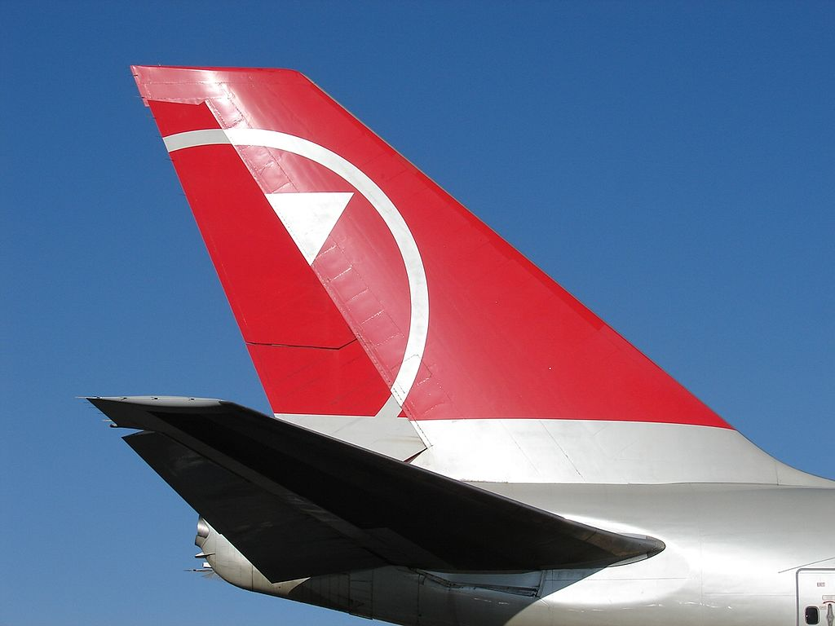
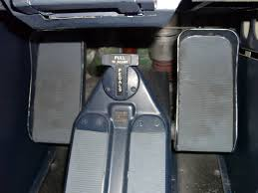
Rudder
Controlls yaw
It is used to turn (with ailerons)
Diflects less as the speed rises

Slide 9
Secondary flight control surfaces
Flaps + slats
Spoilers
Air brake

Slide 10
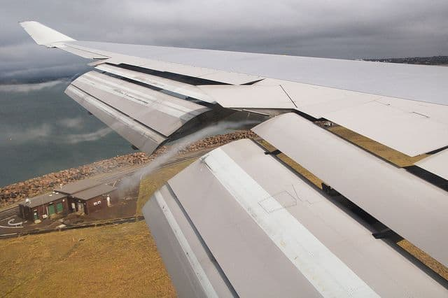
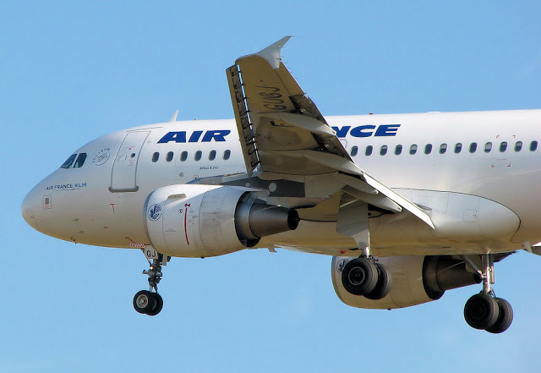
Flaps + slats
They increase the lift
Are located on the trailig edge (flaps) and leading edge (slats) of the wings

Slide 11
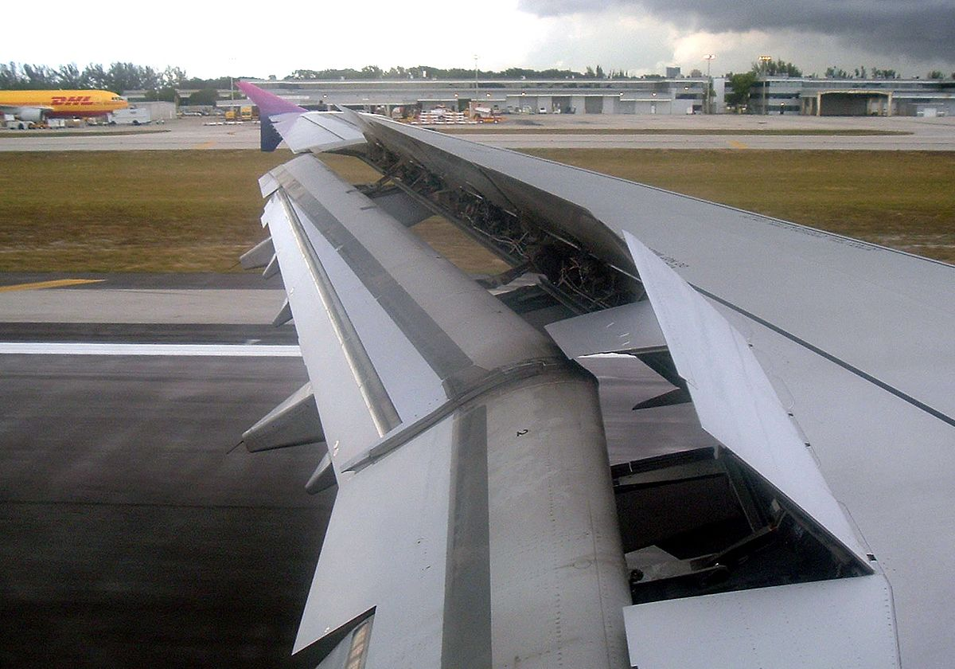
Spoilers
Also called „lift dumpers“
Reduce lift and speed
Always deployed on landing

Slide 12
Cocpit

Slide 13
Thank you for your attention

Slide 14
Sources
https://en.wikipedia.org/wiki/Flight_control_surfaces#Spoilers
https://en.wikipedia.org/wiki/Rudder#Aircraft_rudders
https://www.youtube.com/watch?v=J-TJQimfylA
https://en.wikipedia.org/wiki/Flap_(aeronautics)

